Slide 1
Further Learning
Mr Mack 2021

Slide 2
Webpage design
We've shown you how to make webpages, but we haven't necessarily shown you how to make webpages that look good. Of course, beauty is in the eye of the beholder, so it's ultimately up to you—and your users—to decide whether your webpage looks good. We can give you some tips and tricks, though!
Besides looking good, you probably also want your webpage to look distinct from other webpages so that it stands out to your users.
That's often the hard part—making your webpage look good while also making it look distinct. You can make it awfully distinct by covering everything with zebra stripes and using a 64-pixel font, but should you? Probably not.

Slide 3
Picking good fonts
By default, browsers serve webpages with the generic serif font family, which tends to convey a more formal look to a page. You might decide to change that to the generic sans-serif font family, or you might specify a specific font family that's on most users computers, like Garamond or Helvetica.

Slide 4
Picking good fonts
When you use a web font, you're actually making the user's browser download a font file to the user's computer so you can reference that font file from the CSS. It's an extra download for the browser, so you shouldn't use too many, and you shouldn't include any you don't intend on actually using. One great source of free web fonts is Google Web Fonts.
Wherever you get your fonts from, you should watch out for font overload. Generally, you shouldn't use more than two or three font families on a page, and your fonts should pair nicely together. Here's a helpful website that gives examples of Google Web Fonts that pair well together.

Slide 5

Picking good colors
When designing a webpage, you often want to use a color palette—a range of colors that work well together and can be used for the various parts of your webpage. These colors might be based on your company logo, they might relate to the theme of the page, or they might just look good together.
Need help picking a palette? If you already know a few colors that you want to base the palette on, you could head over to Paletton, a tool that lets you visualize different types of palettes: monochromatic, triads, adjacent colors, and tetrads.

Slide 6
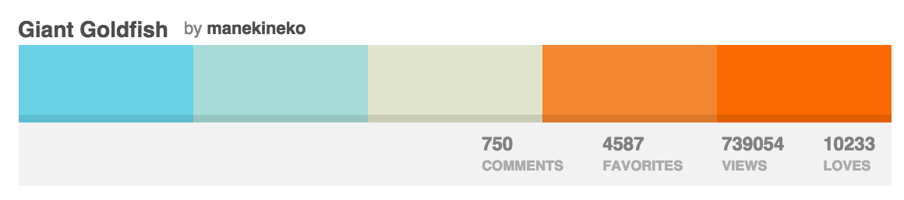
Picking good colors
f you're starting from scratch, you can browse around the palettes at COLOURLovers, a community of people who love colors and contribute color, palette, and pattern ideas. Here's a palette named Giant Goldfish:

Slide 7
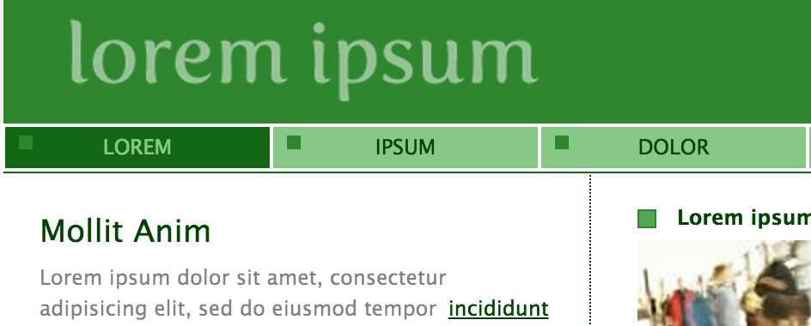
Picking good colors
Once you have a palette picked out, you're to the hard part: figuring out which colors to apply to which parts of your webpage. What color should the headlines be? The links? The text? The background? The great thing about Paletton is that they give you an example webpage that uses the palette:

Slide 8
Picking good colors
As you decide on how your palette will translate into CSS, consider a few things:
If you change the styling of links too much from the default, users may not realize they're links anymore.
The colors of foreground/background text should contrast enough that your users don't need to squint. Check your colors in this contrast checker.
Many humans are color blind. Some color combinations won't have sufficient contrast for them. Check your colors in this color blindness simulator.
If you're not sure about the way you're using your color palette, send it around to a few friends and ask for their honest opinion. Can they read everything? Do they know what's clickable? Do any colors make their noses crinkle? What colors do they love?

Slide 9
Using whitespace well
I once asked my colleague—who's now a designer at Google—what his secret to great design was. His response? Whitespace!
Whitespace refers to any blank space between elements, and in CSS land, it usually comes from properties like padding, margin, and line-height.
My friend is right—whitespace can have a big effect on how good your webpage looks and how easy it is to read. My designer friends sometimes spend hours tweaking whitespace to get it just right, because they know how important it is.

Slide 10
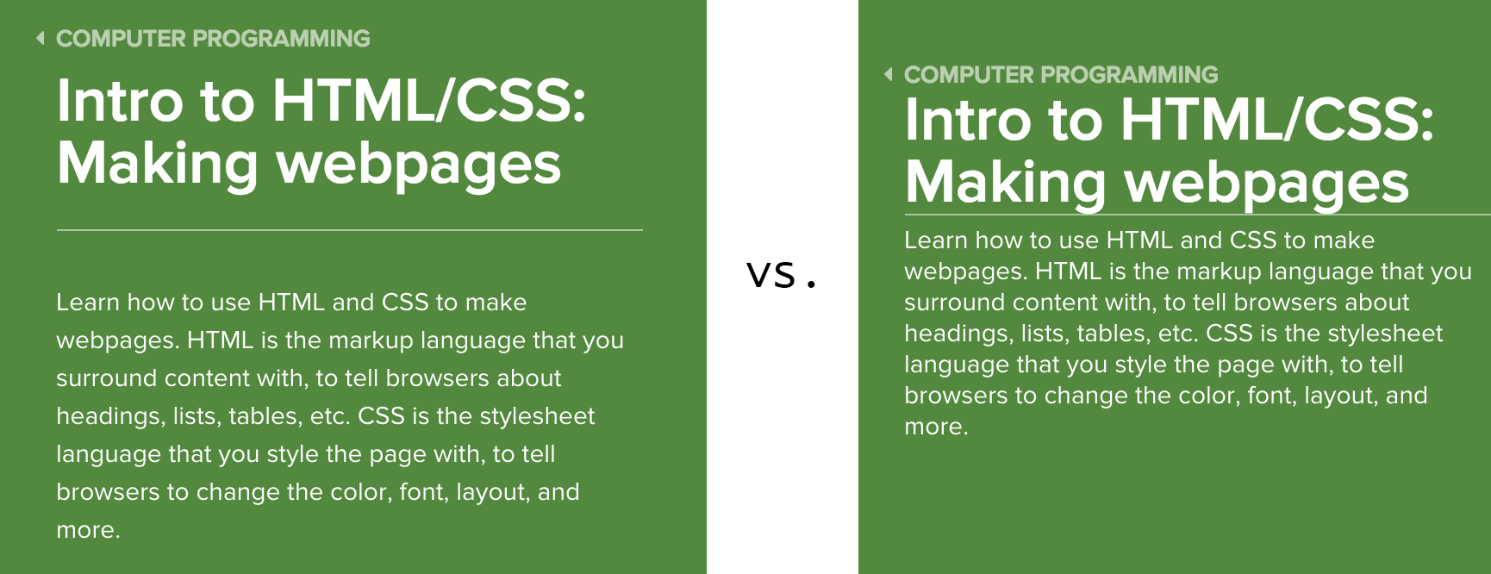
Using whitespace well
For an extreme example, here's a comparison of our course page sidebar with and without whitespace:
Notes:
What does that mean for you? It's hard to give hard and fast rules about whitespace; just be aware of it. Whenever you have an element that's next to another element, consider how much margin is between them. If you have an element with a background or border, consider how much padding they have. When creating paragraphs and lists, consider if extra line-height would give them some reading room.

Slide 11
Starting from templates and frameworks
You might be intimidated after reading all of these guidelines, especially if you don't consider yourselves to have an eye for design. Don't worry, you don't have to be a design expert to have a great looking webpage. Instead, you can start from a template or framework and take advantage of the effort that other designers have put into it.
A template is HTML and CSS that already looks like a complete webpage, often with fake content filled in. You can find templates from W3Schools or by searching the web for "free webpage templates"—and hoping that the ones you find are indeed free! Once you download a template, you can substitute your content and continue modifying the CSS to meet your needs.

Slide 12
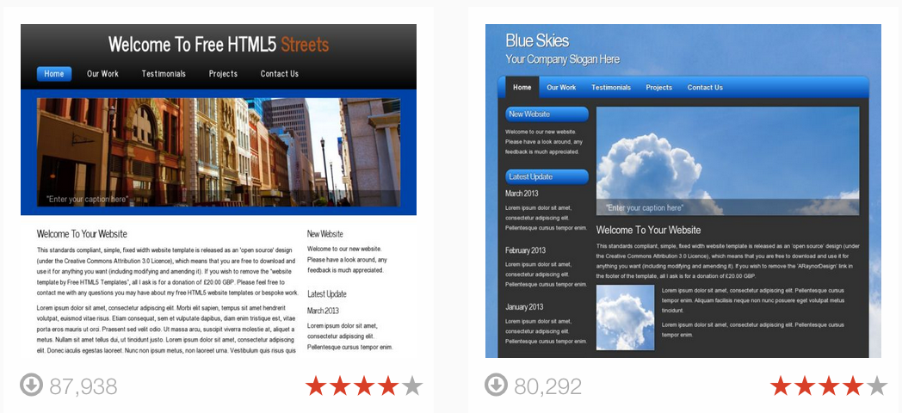
Starting from templates and frameworks
A CSS framework is a collection of CSS rules that give you a great starting point for a slick website. There are many popular CSS frameworks that will make it easier for you to create a beautifully styled website—Twitter Bootstrap, ZURB Foundation, Pure CSS, Topcoat, and more.
Notes:
Once you download a CSS framework, you can browse through the documentation to find examples—they often have templates too!—and figure out what CSS class names will achieve the look you want.
When you use templates or frameworks, you risk your website looking exactly like another website and thus not standing out as much in your user's mind. To avoid that, add in your own logo and change some key elements like the font family or the background color.

Slide 13
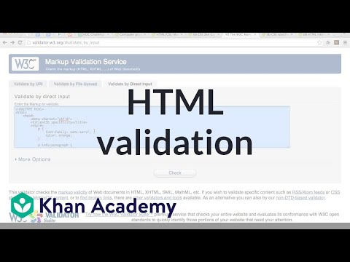
HTML validation

Slide 14
What to learn next
Congratulations on learning HTML and CSS fundamentals! You now understand a lot of what goes into the webpages you see around the internet, and you should hopefully be able to look at those webpages and start to recognize the HTML tags and CSS properties in use.
There is a whole lot more that you can do to build on your HTML and CSS knowledge, however. Read on!

Slide 15
Form tags
here are quite a few tags that are used to create web forms, like <button>s and <input>s. They are typically used to communicate data back to a server. They can also be used with JS to create a game, which we do teach in the HTML/JS course. Learn more about form tags with these slides. Learn server-side languages like PHP, Python, Ruby on Codecademy.

Slide 16
Iframes
The <iframe> tag is a way to frame another webpage inside yours, and is handy for things like embedding Youtube videos, Google Maps, etc. That tag is disabled on Khan Academy currently for security and moderation purposes, but can be experimented with elsewhere. Learn more with these slides.

Slide 17
Multimedia tags
The <audio> and <video> tags are supported in modern browsers as a way to play audio and video files on webpages. Like the <iframe> tag, they are currently disabled on Khan Academy, but can be used elsewhere. Learn more with these slides.

Slide 18
New semantic tags
In the past few years, as part of the "HTML5" specification, browsers have added new semantic tags for developers to use instead of <div>s, when appropriate, such as <article>, <aside>, <nav>, etc. There are many articles about them here, including this handy flowchart for deciding when to use them.

Slide 19
CSS3
We covered CSS that's been supported in browsers for years, but there are many new CSS properties and selectors in what's known as the "CSS3" specifications, and browsers are adding support continuously as they release new versions. You can learn more in these CSS3 selectors slides, and CSS3 properties slides. Make sure to check caniuse.com to find out what's supported in each browser.

Slide 20
Media queries
This is a technique that lets you specify different CSS for different situations, like when your webpage is viewed at a smaller size or when it's printed. Learn more from W3C.

Slide 21
CSS frameworks
A framework is a collection of CSS rules and classes, and many developers use CSS frameworks to enable them to write CSS faster. The most popular one is Twitter Bootstrap, but there's also ZURB foundation, Pure CSS, Topcoat, and more.

Slide 22
Using JS in webpages
Web developers use JavaScript to make webpages interactive, to respond to user events and bring in data dynamically from servers. They do that by embedding <script> tags inside the HTML, and putting JavaScript inside those tags. Their JS code then uses the "DOM API", a set of functions that browsers make available on every webpage to let developers query and manipulate that page.
We will go over this soon!

